Slide 1

An Introduction to Deep Reinforcement Learning
Gaurav Malave
Hemanth Sai Manikanta
Eedara Sri Rahul
Pradipth Gautam S
1

Slide 2
Agenda
Types of Machine Learning
Reinforcement Learning Fundamentals
Mathematical Framework
Two Main Learning Approaches
Deep Q-Networks (DQN)
DQN Loss Function Derivation
DQN Algorithm Summary
DQN Improvements & Variants
Problems with Original DQN
Double DQN: Addressing Overestimation
Dueling DQN: Architectural Innovation
Dueling DQN: Mathematical Foundation
Summary & Impact

Slide 3
Types of Machine Learning:
🎯 Supervised Learning
Data: Input-output pairs (X, Y)
Goal: Learn mapping f: X → Y
Examples: Classification, Regression
Feedback: Immediate correct answers
🔍 Unsupervised Learning
Data: Only inputs (X)
Goal: Discover hidden patterns
Examples: Clustering, Dimensionality Reduction
Feedback: No explicit feedback
🎮 Reinforcement Learning
Data: States, Actions, Rewards
Goal: Maximize cumulative reward
Examples: Game playing, Robotics
Feedback: Delayed rewards/punishments
Key Difference: RL learns through trial-and-error interaction with an environment, receiving sparse and delayed feedback.

Slide 4
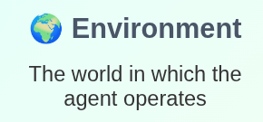
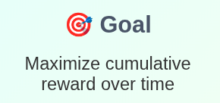
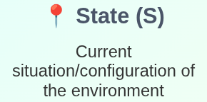
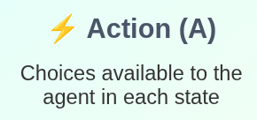
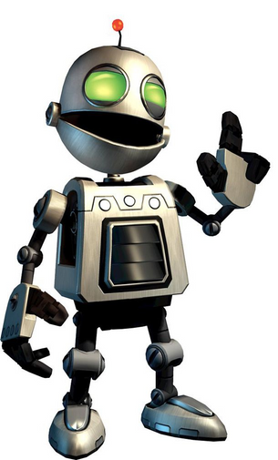
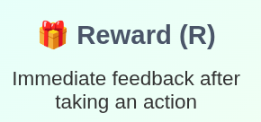
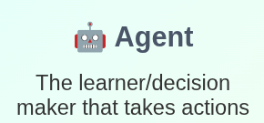
Typical RL scenario
Environment
State
Action
Reward
Agent

Slide 5
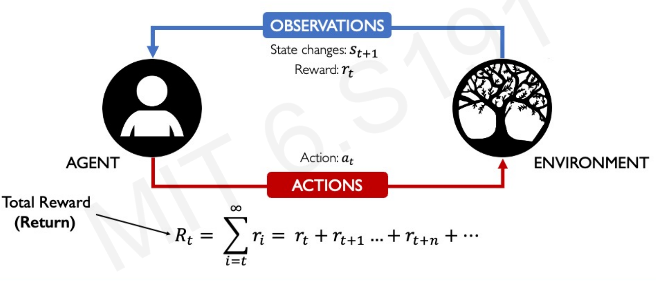
Mathematical Framework:

Slide 6
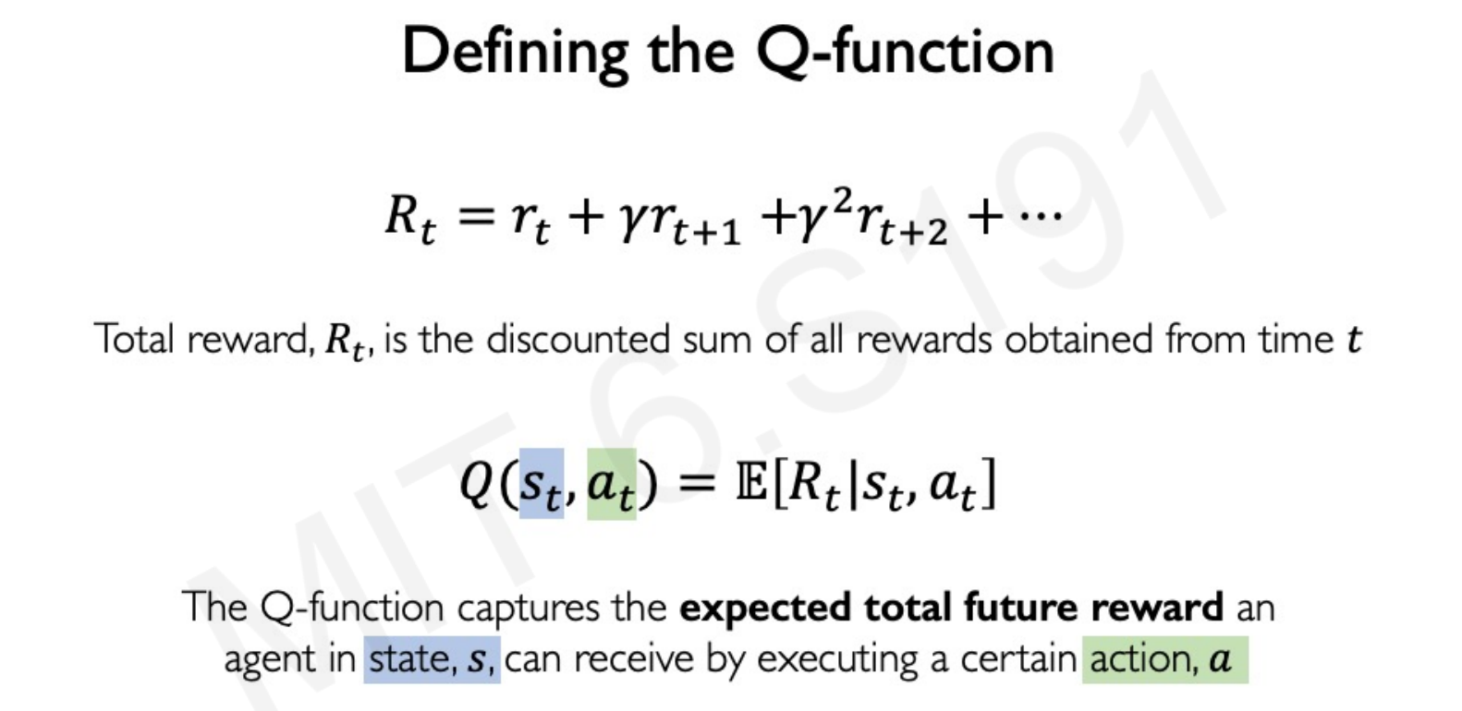
Mathematical Framework:

Slide 7
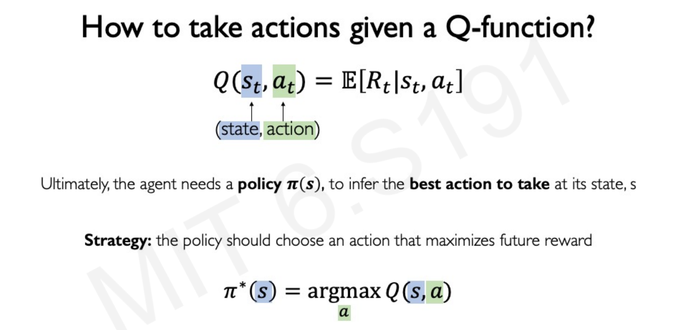

Mathematical Framework:

Slide 8
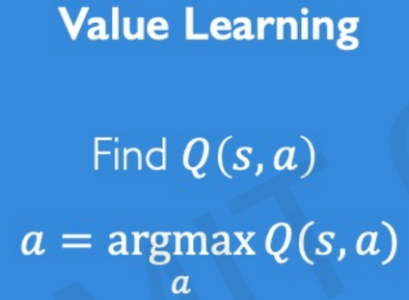
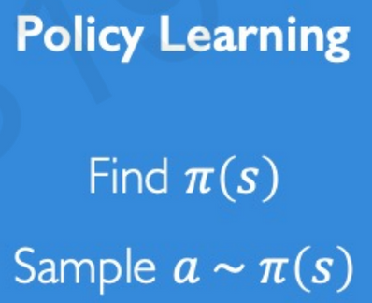
Two Main Learning Approaches:
🎯 Policy Learning
Strategy: Directly learn the optimal policy
Key Idea: Optimize policy parameters to maximize expected return
Objective: Sample a ~ π(s)
Methods: REINFORCE, A3C, PPO
Pros: Works with continuous actions
Cons: High variance, less stable
📊 Value Learning
Strategy: Learn the value of states/actions
Key Idea: If we know Q(s,a) for all actions, we can choose the best one
Policy Derivation: π(s) = argmax Q(s,a)
Methods: Q-Learning, SARSA, DQN
Pros: Sample efficient, stable
Cons: Limited to discrete actions
*Modern Approach: Actor-Critic methods combine both approaches

Slide 9
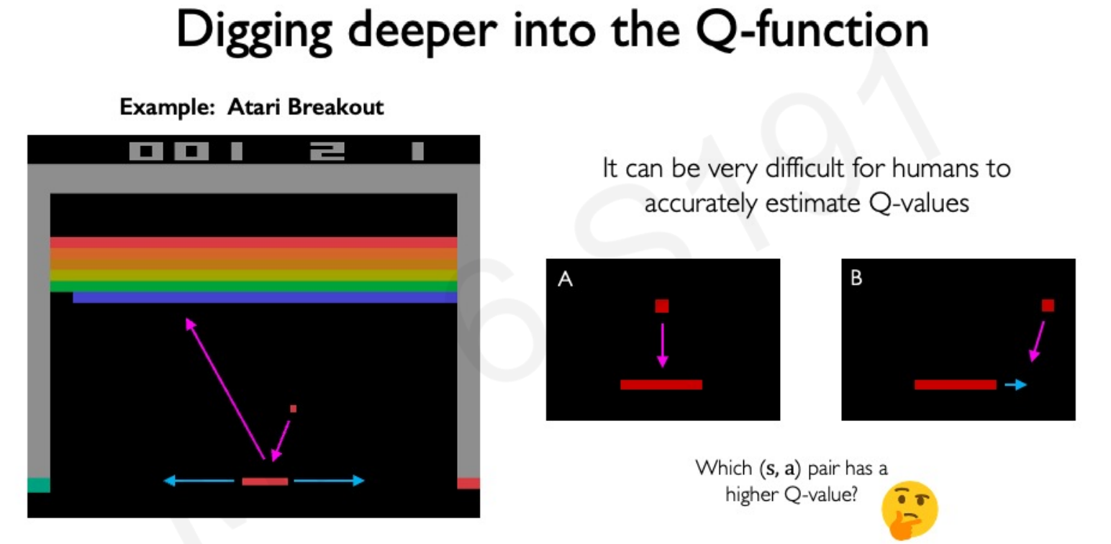
Deep Q-Networks (DQN):

Slide 10
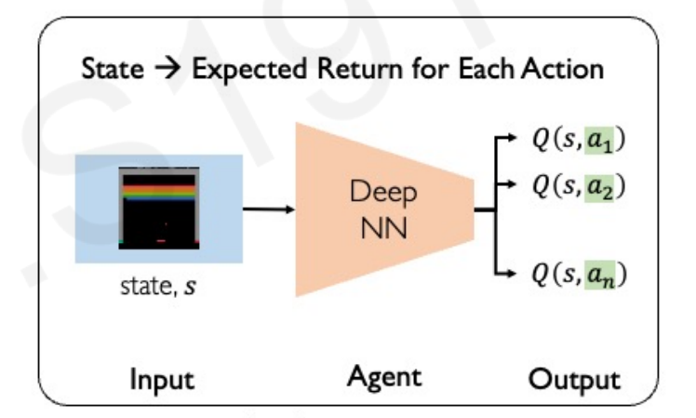
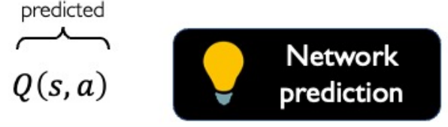
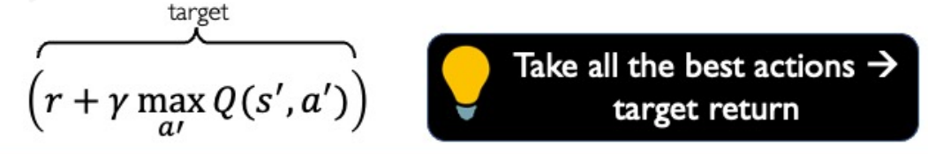
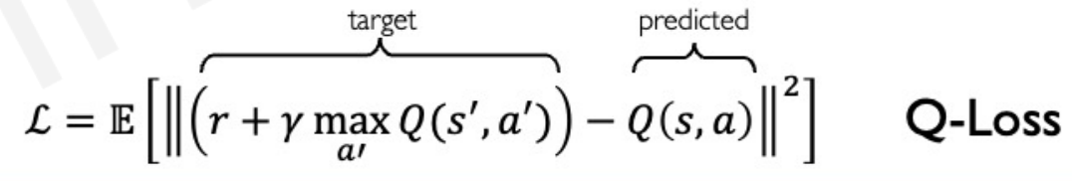
Deep Q-Networks (DQN):

Slide 11
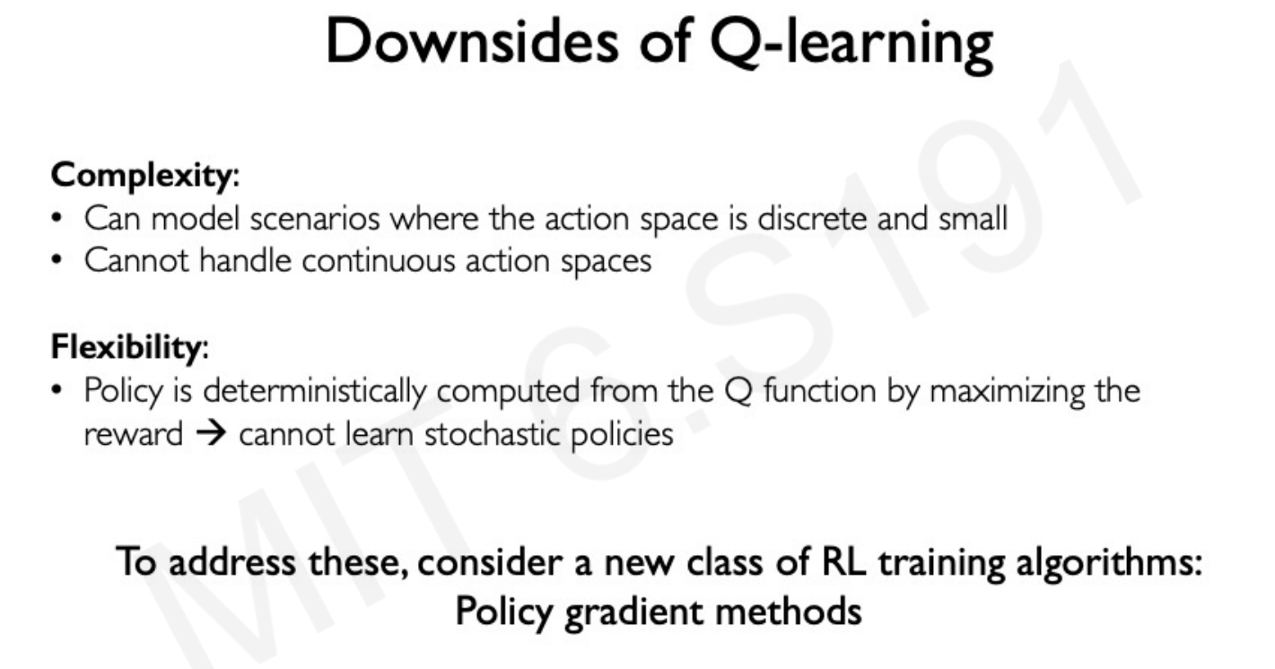

Slide 12
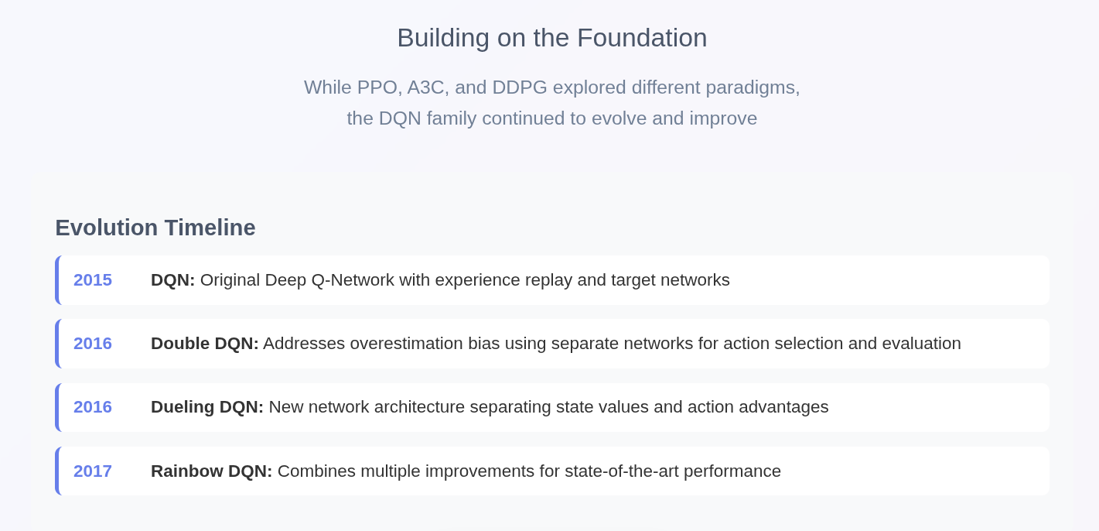
DQN Improvements & Variants

Slide 13
🎯 Overestimation Bias
DQN systematically overestimates Q-values due to the max operator
Target: y = r + γ max_a' Q(s',a'; θ⁻)
Problem: The same network both selects and evaluates actions
01
Problems with Original DQN
🧠 Inefficient Learning
The network learns Q(s,a) directly, but doesn't explicitly separate:
State value: "How good is this state overall?"
Action advantage: "How much better is this action compared to others?"
02

Slide 14
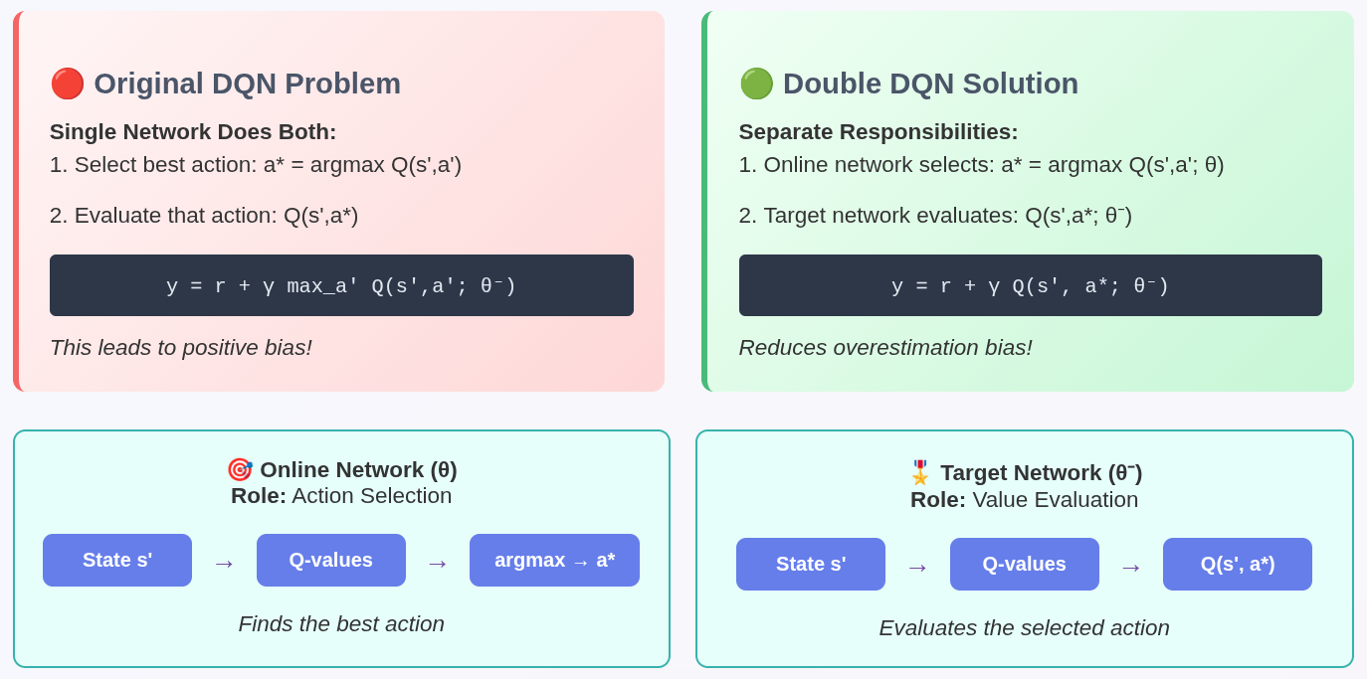
Double DQN: Addressing Overestimation

Slide 15
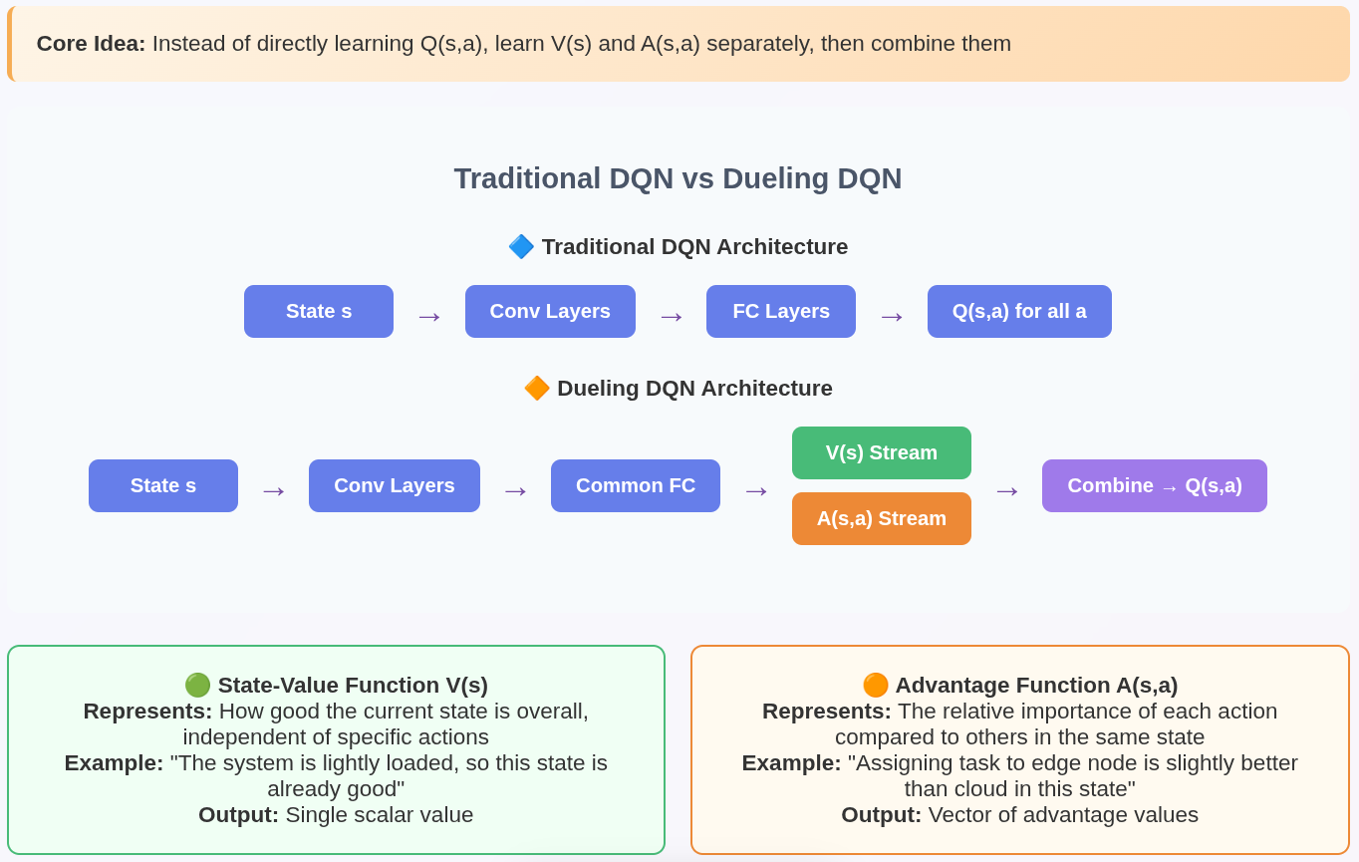
Dueling DQN: Architectural Innovation

Slide 16
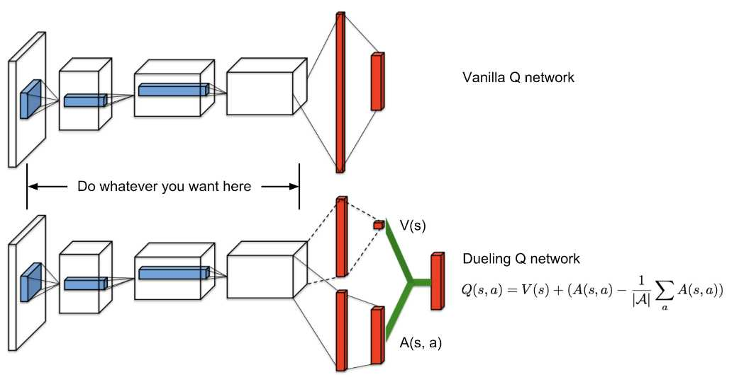
Dueling Q network

Slide 17
Thank You

